Slide 1
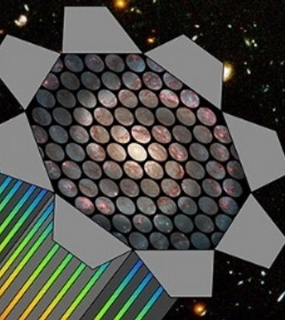
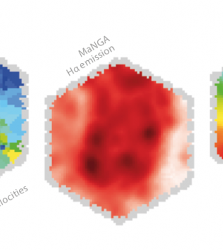
Internal Kinematics of Galaxies in Relation to their Morphological Evolution Using MaNGA Survey
Juan Pablo Alfonzo
Advisor: Dr. Mubdi Rahman

Slide 2
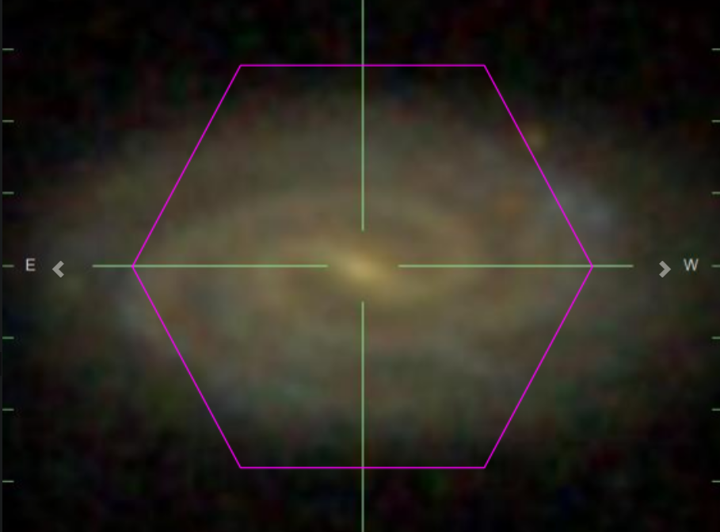
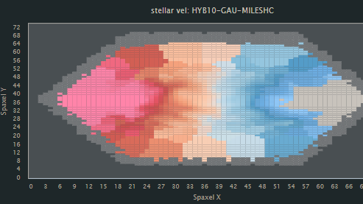
Research Goal
Studying internal kinematics between the 3 major types of galaxies
Star Forming Galaxies (SFGs)
Quiescent Galaxies (QGs)
Green Valley Galaxies (GVGs)
What makes MaNGA Survey Unique?
Spectral Measurements across the face of 10,000 different galaxies at low red-shifts
How are trends being studied?
Primary Component Analysis (PCA)
Source: [1]

Slide 3
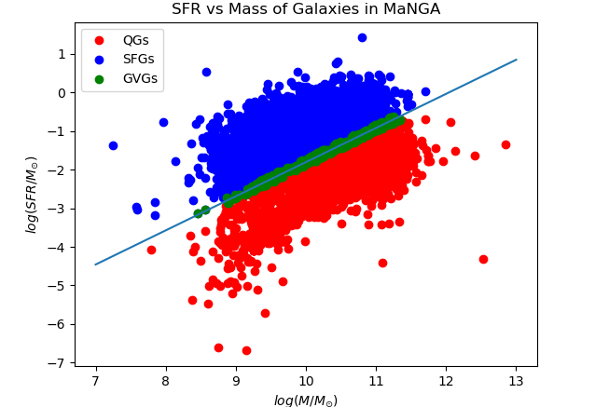
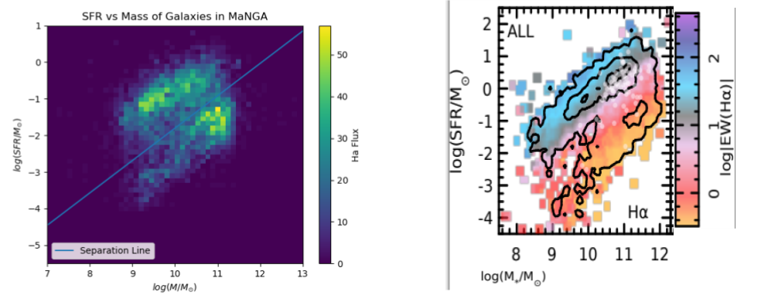
Classification 1: Log SFR vs Log Mass
Source: [2]

Slide 4
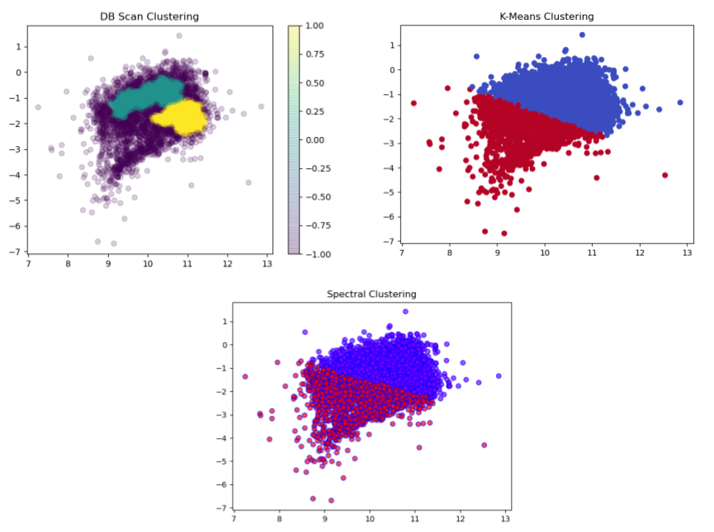
Classification 2: Clustering Algorithms

Slide 5
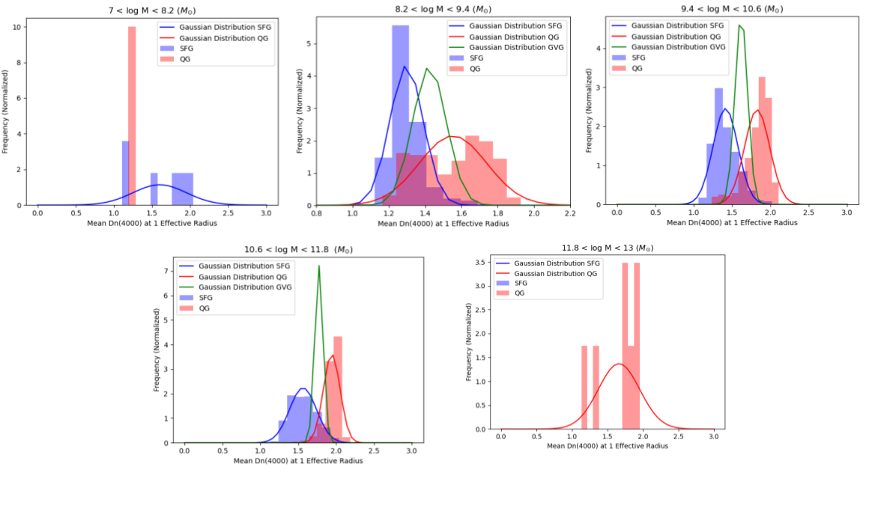
Classification 3: Gaussian Distributions
Source: [3]

Slide 6
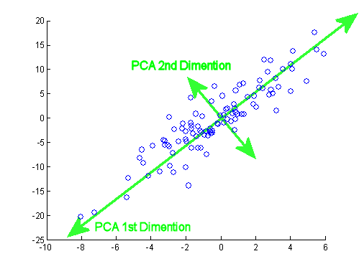
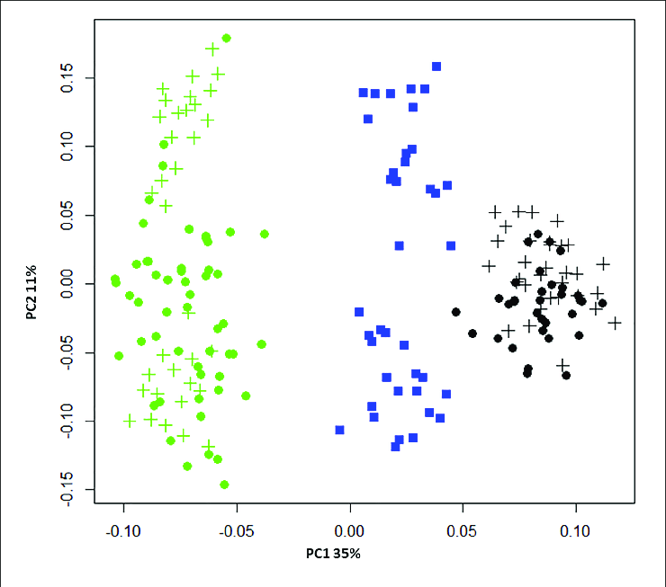

Crash Course in PCA

Slide 7
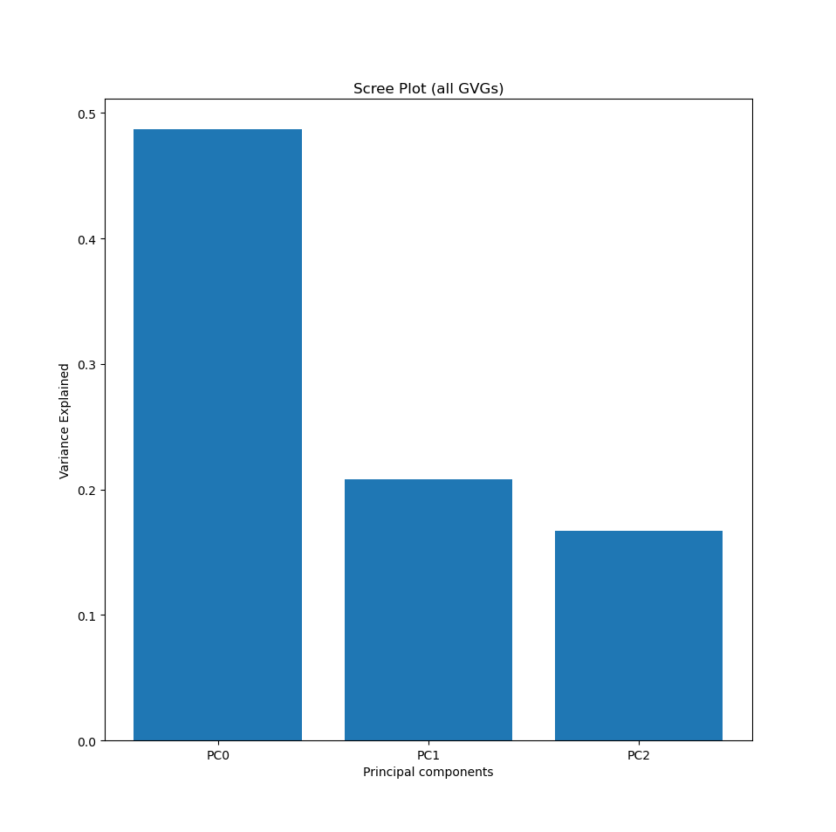
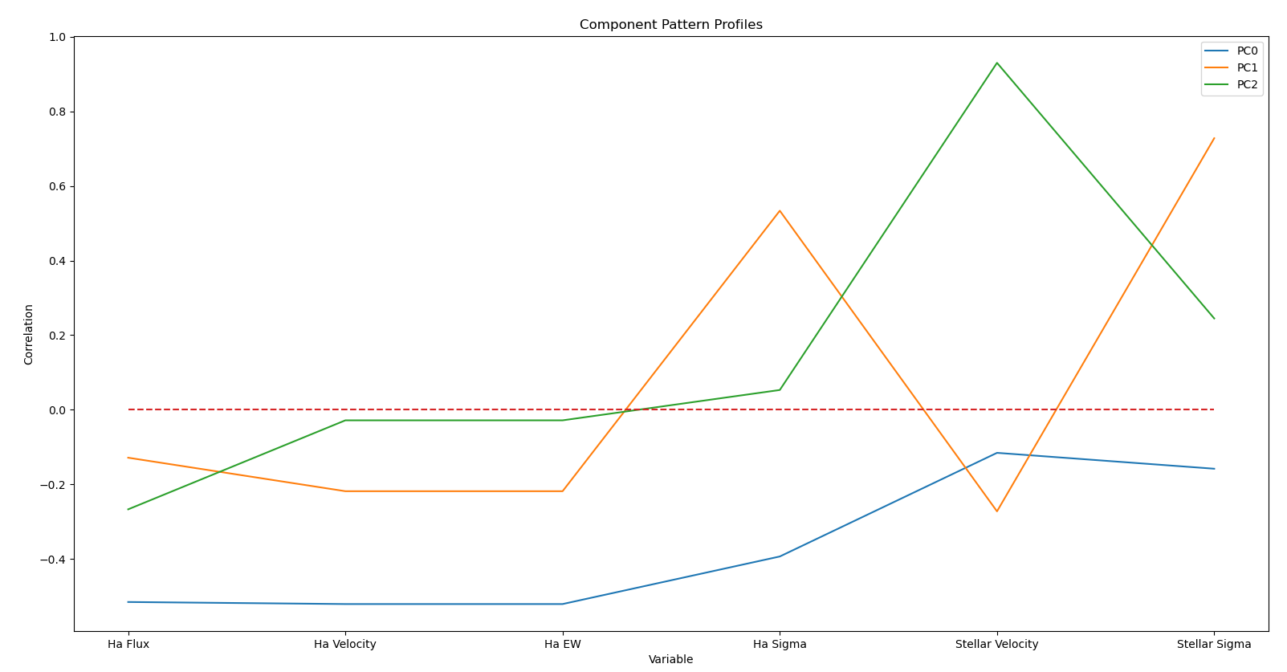
Preliminary PCA Analysis

Slide 8
Future Research Plan
Improve on profile plot shown in previous slide
Bootstrap the PCA to get measure of how it reacts to noise and give us an error measurement
Feed PCA various pixel maps from various galaxies at once
Add in non pixel specific data (Mass, SFR, Effective radius, etc.)
Taking the PC vectors and changing them into the basis on the original pictures of the galaxies taken by MaNGA
The most meaningful part of the project will come in trying to explain the trends that emerge during this phase of the project in terms of physical phenomenon and the laws that govern them

Slide 9
Sources
[1] Sebastian F. Sanchez. Spatially-Resolved Spectroscopic Properties of Low-Redshift Star-Forming Galaxies. Annual Review of Astronomy and Astrophysics, 58, 2020.
[2] Brian Cherinka, Brett H. Andrews, Jose Sanchez-Gallego, Joel Brownstein, Maria Argudo-Fernandez, Michael Blanton, Kevin Bundy, Amy Jones, Karen Masters, David R. Law, Kate Rowlands, Anne-Marie Weijmans, Kyle Westfall, and Renbin Yan. Marvin: A Tool Kit for Streamlined Access and Visualization of the SDSS-IV MaNGA Data Set. , 158(2):74, Aug 2019.
[3] Ignacio Ferreras James Angthopo and Joseph Silk. Exploring a new definition of the green valley and its implications. Monthly Notices of the Royal Astronomical Society, 488, 2019.

Slide 10

Thanks for Listening!

